Slide 1
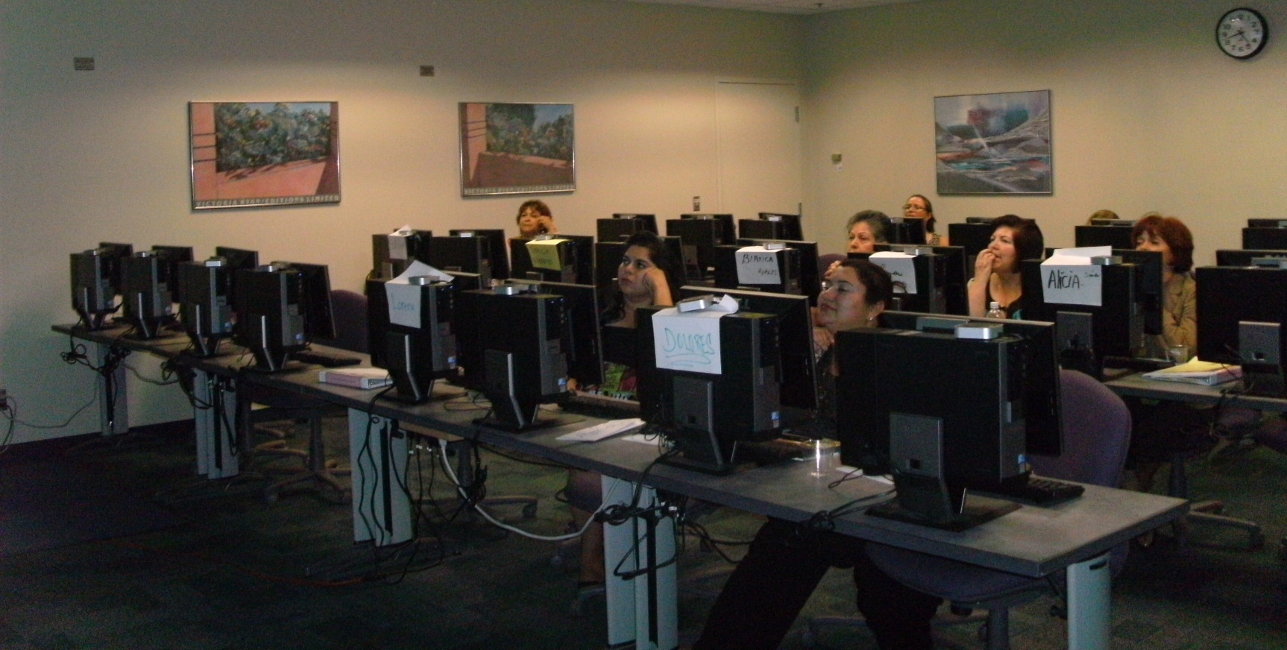
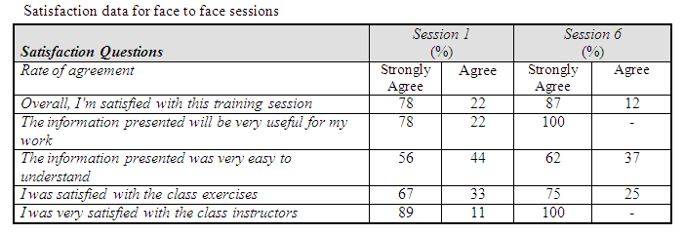
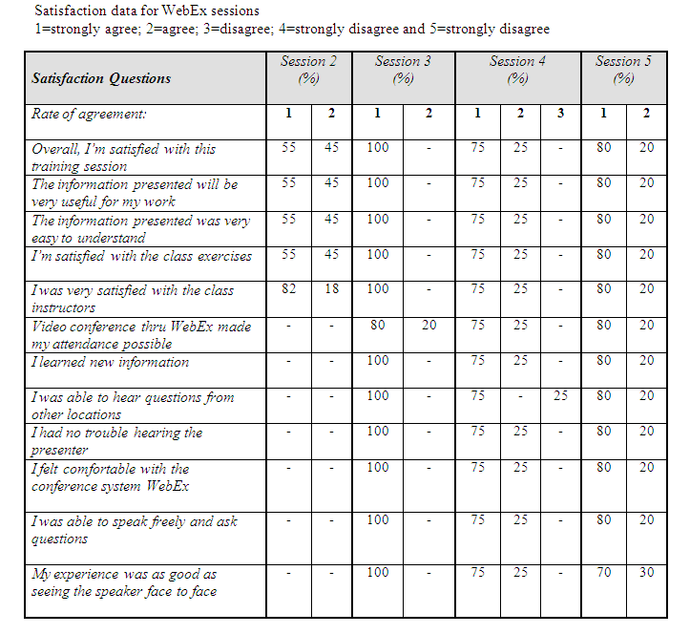
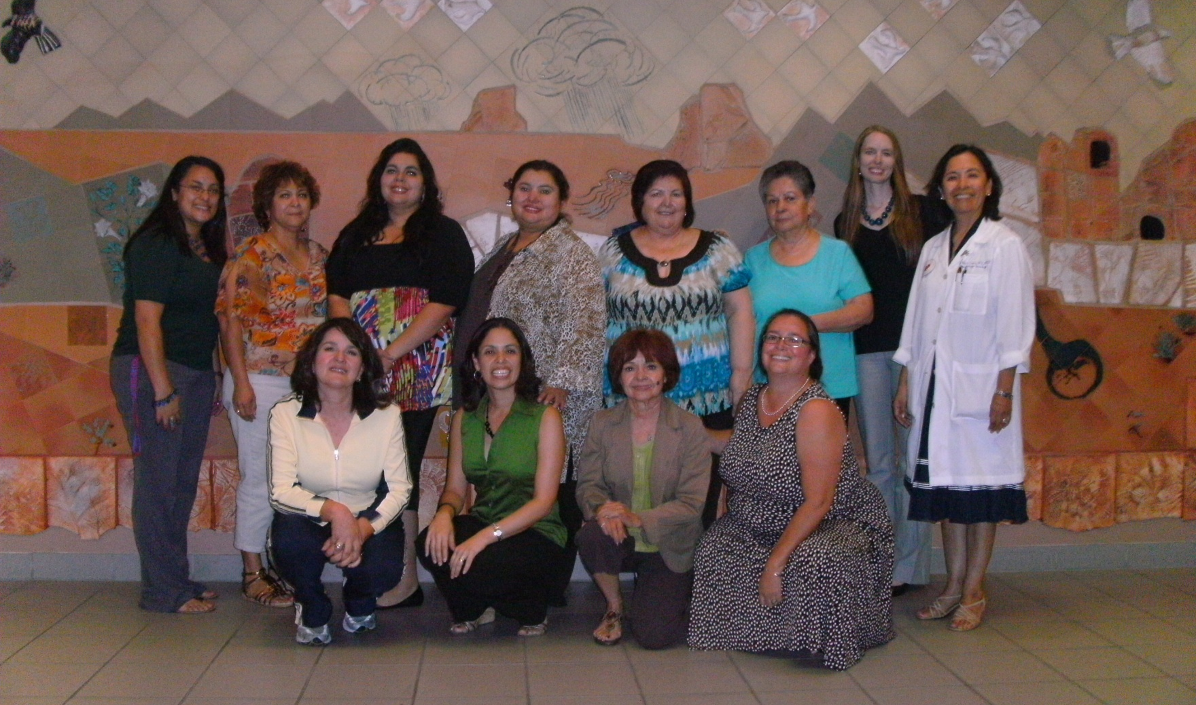
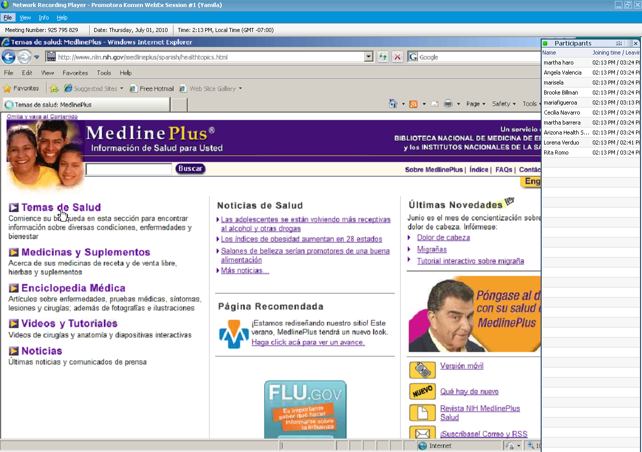
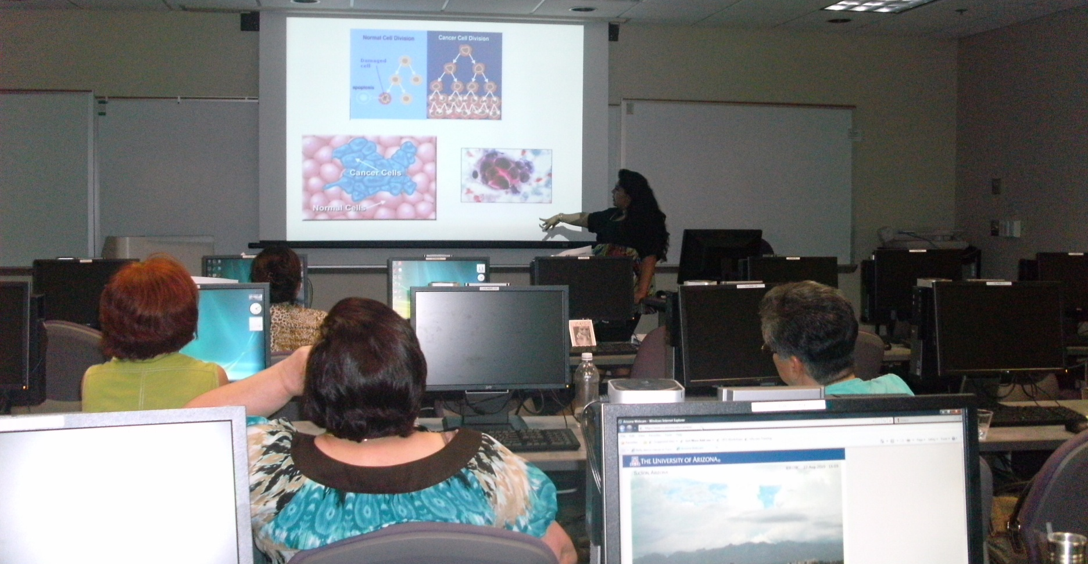
Web-Based Computer and Health Literacy Program
Tailored for Promotores/Community Health Workers Along the Arizona-Mexico Border
Jeanette Ryan, AHIP, Deputy Director, Arizona Health Sciences Library, University of Arizona, Tucson, AZ; Ana Maria Lopez, M.D., M.P.H., F.A.C.P, Associate Dean, Outreach and Multicultural Affairs, Arizona Cancer Center;
Yamila M. El-Khayat, Outreach Librarian; Brooke L Billman, AHIP, AZHIN Librarian; Annabelle Nuñez, Mel & Enid Zuckerman College of Public Health Liaison Librarian; Angela Valencia, MPH Research Specialist Senior, Arizona Cancer Center;
Introduction
Results
This poster shows the effectiveness of a face-to-face and web-based computer literacy curriculum designed by the Arizona Health Sciences Library (AHSL), in collaboration with the Arizona Cancer Center, and funded by Susan G. Komen for the Cure, for promotores/community health workers (CHWs) on breast cancer topics as well as the production of educational pamphlets and presentations for the communities they serve. The program’s main objective was to develop and deliver a collaborative computer literacy curriculum for community health workers in Southern Arizona. The program’s specific objectives included the following:
Conduct assessments of informational needs and resources relating to Breast Cancer in the Promotores’/CHW’s communities in Arizona.
Develop and deliver a series of six computer-literacy educational sessions on breast cancer resources including two face-to-face sessions.
Develop a sustainable program for continuing computer-literacy education via endurable web-based resources and recorded DVDs.
Survey results indicated that approximately 80% of the information was new for the participants. It was noted in the survey that much of the information provided was valuable. All students felt that the information learned would be of value to their work as promotores/CHWs.
Post-test showed that all participants were able to name and save a document, as well as draft and send an email with the saved document attached. Approximately 85% of class participants correctly demonstrated creating a document with an ascribed text format style and inserted photo. Approximately 50% of these students learned how to properly use the word count tool.
Methodology
In order to capture participants’ informational needs, resources, computer skills and demographics, a bilingual Spanish/English self-assessment was administered to 26 promotores/CHWs, all working in agencies along the Arizona-Mexico Border. The results indicated a low level of computer literacy among many of the participants, along with a lack of accurate health informational searching skills. Results also indicated very little experience using tools for online discussions and forums.
A training program was developed to better help identify the needs of these communities. The instructors reviewed and analyzed all assessments and existing materials to create new educational materials that would incorporate linguistically appropriate material along with cultural values.
Curriculum and Material Development:
Based on the initial computer assessment data, a computer literacy and information seeking and evaluation curriculum (6 sessions – 2 in person, 4 webinars) was developed to address the promotores’/CHW’s specific needs. Promotores/CHWs were trained in the following areas:
Basic computer skills and web conferencing training
Where to find reliable Breast Cancer information on the web
Web evaluation
Health calculators and tools
Support group information, nutrition and Complementary and Alternative Medicine
Extreme Googling
Grant databases
How to set up a health fair
Background
Breast Cancer is the most common cancer diagnosed in women residing in Arizona. A large lack of breast health knowledge is a factor that contributes to lower levels of diagnosis at the time of screenings. A recent study that developed a decision support intervention among Latinas, found that Breast Cancer knowledge at the time of diagnosis was low. Most participants reported that they had not received Breast Cancer information in their own language or that their physician had not used terminology that they could understand (Sheppard, 2008).
Health information technologies are exploding and access to this health information is not uniform, resulting in large health knowledge gaps for underserved populations.
Definition of a Promotor/CHW:
Promotores/CHWs are individuals that are highly respected in their communities, who undergo specific health education trainings to serve as effective outreach health workers who can bridge the medical world gap in their own communities.
Conclusion & Future Work
This program successfully developed and delivered a computer literacy curriculum for promotores/CHWs in southern Arizona. A total of 17 self- identified Latina promotores/CHWs participated in the program. Fifty three percent of the participants have an educational background of high school level or lower. The participants were residents from Nogales, Douglas or Tucson. All participants learned how to use reliable health information databases, create informational brochures, evaluate websites, and create power point presentations. The participants indicated high levels of satisfaction with the program content, and with the methods of delivery. All reported to have attained substantial improvements in computer literacy.
Due to budgetary, travel, and time constraints, the web-based sessions proved to be an effective source for educational instruction to the promotores/CHWs. All sessions were recorded and alternatively accessible for participants who could not make the meeting times.
An additional set of classes is being planned for a new group of promotores/CHWs. This set of classes will be delivered electronically and will include the use of social networking to share health information.
Reference: Sheppard V.B., Figuerido M., Canar J., Goodman M., Caicedo L., Kaufman A., et.al. (2008) Latina a Latina: developing a breast cancer decision support intervention. Psycho-Oncology 17:383-391

