Slide 1

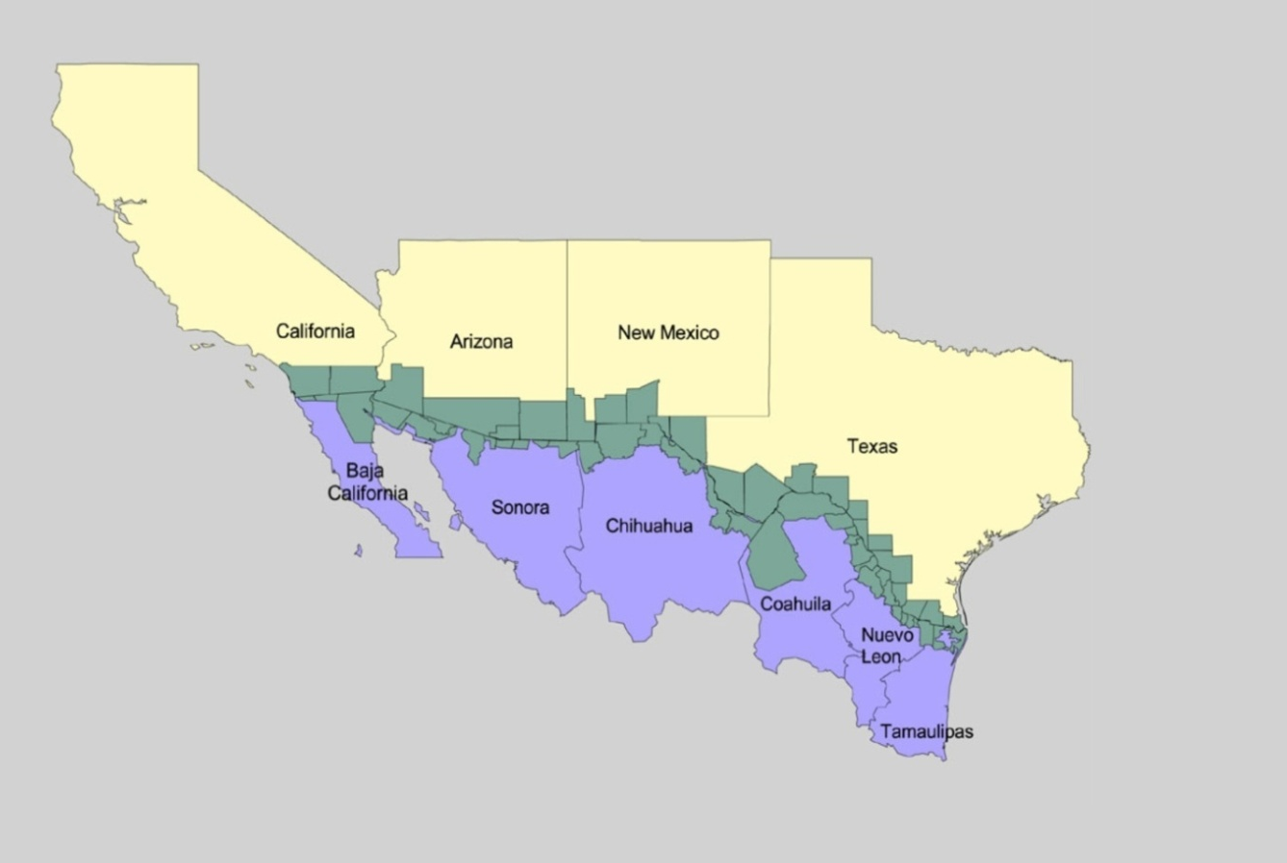
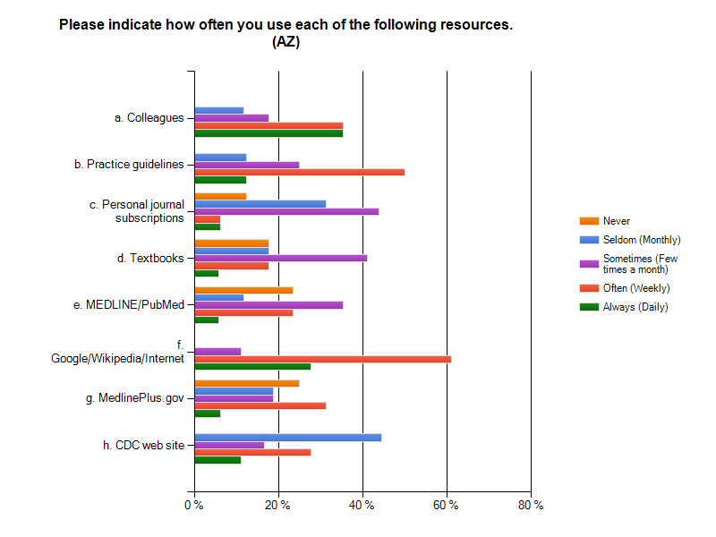
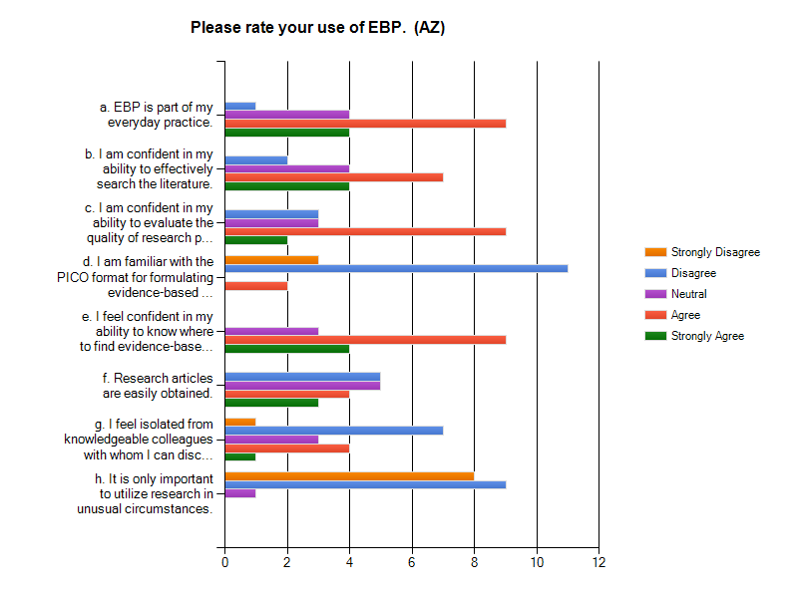


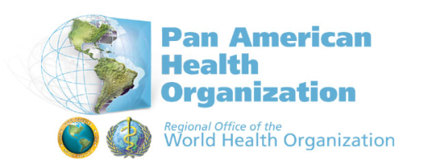



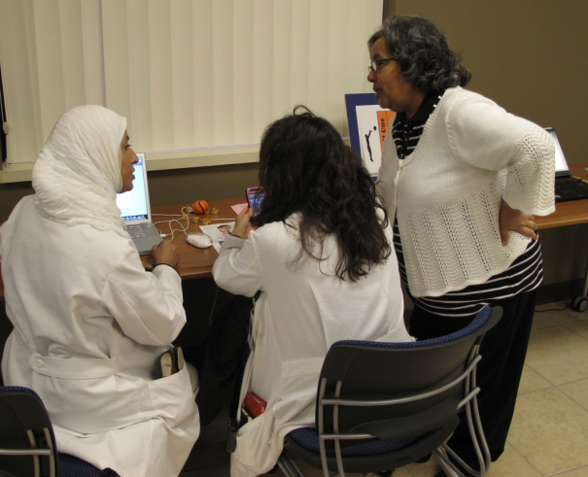
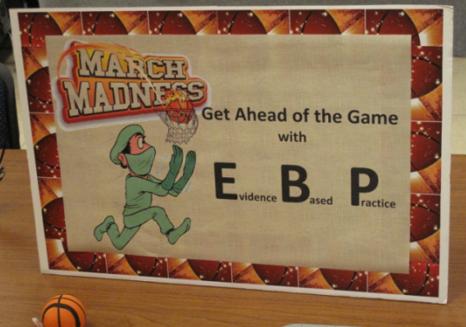
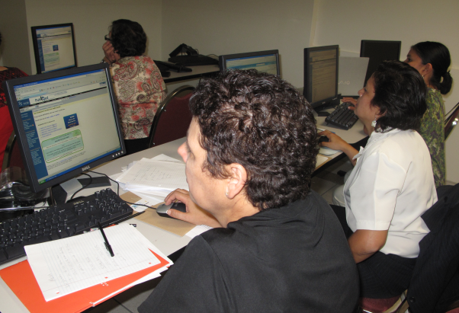
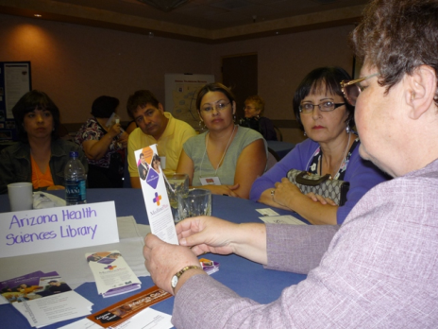
The Frontera Collaboration:
Promoting Evidence-Based Practice in the US-Mexico Border Region
Brooke L Billman, Annabelle Nuñez, Yamila El-Khayat, Jeanette Ryan, University of Arizona | Keith Cogdill, Kathleen Carter, Graciela Reyna; University of Texas Health Science Center at San Antonio
Lorely Ambriz; Pan American Health Organization United States-Mexico Border Office | Barbara Nail-Chiwetalu, Pat Bradley ; The University of New Mexico
Patricia Ciejka, Brett Kirkpatrick, Julie Trumble ; University of Texas Medical Branch
INTRODUCTION
This poster describes the formation and early work of the Frontera Collaboration, a partnership of health sciences libraries in US-Mexico border states, with specific focus on Arizona. The goal of the Collaboration is to increase cooperative efforts among health sciences libraries aimed at improving clinical care and public health in the border region. Sponsored by the National Network of Libraries of Medicine (NN/LM) for an initial 18-month period of performance, the Frontera Collaboration libraries share three objectives:
Conduct assessments of needs and resources related to promoting evidence-based practice in the border region;
Develop a strategic plan for continued collaboration in the 2011-2014 timeframe;
(3) Conduct a limited number of outreach activities aimed at border clinicians and public health workers, including conference exhibits and pilot training events that rely on collaboratively developed instructional resources.
Each participating member also follows a “local activity plan” for reaching out to clinicians and/or public health personnel in specific communities in the US-Mexico border region.
METHODS
The early work of the Frontera Collaboration focused on conducting an assessment of needs and resources related to evidence-based practice among border clinicians and public health personnel. As part of this assessment, Frontera Collaboration participants assessed the learning needs of clinicians and public health personnel. through an online survey and interviews with key informants. The Frontera Collaboration also developed asset maps that serve as an inventory of information resources and services available to clinicians and public health personnel in border communities.
FINDINGS
Findings are now informing the collaborative development of instructional materials to be used in pilot training events for clinicians and public health personnel. These instructional materials will emphasize the priority areas identified in the learning needs assessments and point to the information resources and services specified in the asset maps.
CONCLUSION
The Frontera Collaboration brings together NN/LM members in US-Mexico border states to promote evidence-based practice among clinicians and public health personnel in the border region. This collaboration is extending the work of the HRSA-sponsored Consortium of US-Mexico Border Centers of Excellence, begun in 2000.
ASSESSMENT OF NEEDS SURVEY
58 respondents
  19 from Arizona
        50% public health professionals
        50% have 11+ years of practice
        experience on the border
How Does EBP Differ in Border Communities?
Lack of evidence-based information on Hispanic/Latino communities
Models have often not been tested with Hispanic/Latino communities, especially those that are of Mexican heritage and immigrant[s].
EB [information] may be from groups that are not minority groups on the border. Studies that I look for are [the ones] that have relevance to these groups.
Importance of binational communication and cooperation
The communication between governments has… been inconsistent. Although best practices may be practiced on either side of the border, the medical decisions made may not be in the best interest of the patient due to incomplete information.
There are different countries involved that have different political systems, government structure, health systems, languages and educational systems. Working to coordinate efforts and information is sometimes difficult.
Limited access to care
Patient can't afford drugs so may buy other drugs on the other side… also [many] can't afford to travel to doctors or the waiting time to get an appointment/see a doctor is terrible; more doctors won't see Medicaid patients or patients with no insurance, so even basic care is difficult [to access]..
Border physicians sometimes have to hospitalize patients to get them certain types of care (“working the system” by diagnosis), which is not cost-effective.
Limited access to the research literature
In some of the more rural communities there may be less access to published literature (there is no close by health sciences library).
Availability of prescription medications in Mexico
We were taught the first thing you do in cellulitis is amoxicillin or Keflex. But… here that is not valid – you have to start with Bactrim… The incidence of MRSA is so high… They go to Mexico… you have to understand that they have stocks of Cipro in their house… So it is totally different Books do not teach you that. It’s border medicine. [Feb 2009 focus group]
Importance of environmental health
The frequency of birth defects in border communities leads to the question of whether they can be attributed to environmental factors. The funding to study this issue has been inadequate.
Common use of complementary/alternative therapies
Patients use herbals/alternative therapies that are part of their culture instead of or in addition to prescribed medications (and despite possibilities of drug interactions).
Specific conditions
Diabetes is probably more common along the border than anywhere else in [New Mexico] except for the Indian reservations.
University of Arizona
University of New Mexico
UT School of
Public Health
UT Medical Branch
PAHO
US-Mexico Border Office
UTHSC San Antonio
UTHSC San Antonio
Ramirez Library
EBP LEARNING NEEDS: PRIORITY AREAS
PICO format for formulating search-able questions
Searching the literature effectively
Options for obtaining articles
ASSET MAPS
State-specific and border-wide asset maps
Article delivery and other library services
Community health websites
Separate border-wide asset maps for clinicians and public health personnel
Disseminated as part of training sessions
NEXT STEPS
Outreach activities: training sessions and exhibits for clinicians and public health personnel
Participation of libraries in Mexican border states
This project has been funded in whole or in part with Federal funds from the National Library of Medicine, National Institutes of Health, Department of Health and Human Services, under Contract No. N01-LM-6-3505,
with the Houston Academy of Medicine-Texas Medical Center Library.

