Slide 1
A Strategy to Gather and Analyze User Feedback Quickly
Jill A. Crussemeyer, Ph.D., MLIS; Judy Kraemer, MLIS, MBA; Elizabeth A. Mason, B.A.; and Carol Schechter, MLS

Slide 2
Problem
We needed to provide management objective opinions of our users in a very short time frame.
Limitations:
Staff availability
Time to obtain user opinions
Time to analyze user feedback

Slide 3
Solution
We identified library related categories (LRCs) which translate the “big picture” easily to management
Physical space/library image
Role of the library in patient care
Information access
Preference of print vs. electronic formats
Library services
Once LRCs were established, we generated statements relating to the LRC and asked users to rate their level of agreement.

Slide 4
Method
We developed 21 statements for the survey relating to the LRCs and level of user agreement.
Scale: 5= strongly agree, 4=agree, 3=neutral/undecided, 2=disagree, 1=strongly disagree
A No Opinion option was also given
Two questions requested demographic information (e.g. department, job title)
A space for comments was provided at the end of the survey.
The survey distributed via both Survey Monkey & hard copy format.
Results from hard copy surveys were entered into Excel and Survey Monkey Results were downloaded in CSV format.

Slide 5
Method (continued)
Level of agreement was translated to numeric value in Excel using the “Find & Replace” function.
No answer (N.A.) was assigned a 99
No opinion (N.O.) was assigned a 98
The number of responses at each agreement level was determined using =COUNT and =COUNTIF functions in Excel
Percentages were determined as follows:
For N.A. and N.O., the total for these levels were summed together and divided by the total number of surveys completed.
The other percentages were determined by dividing the respective totals by the number of surveys expressing an opinion.
Unfinished surveys were not included in the final results.

Slide 6
Results
234 completed surveys
155 completed online (169 started – 91.7% completion)
79 hard copy (service desk and meeting attendees)

Slide 7
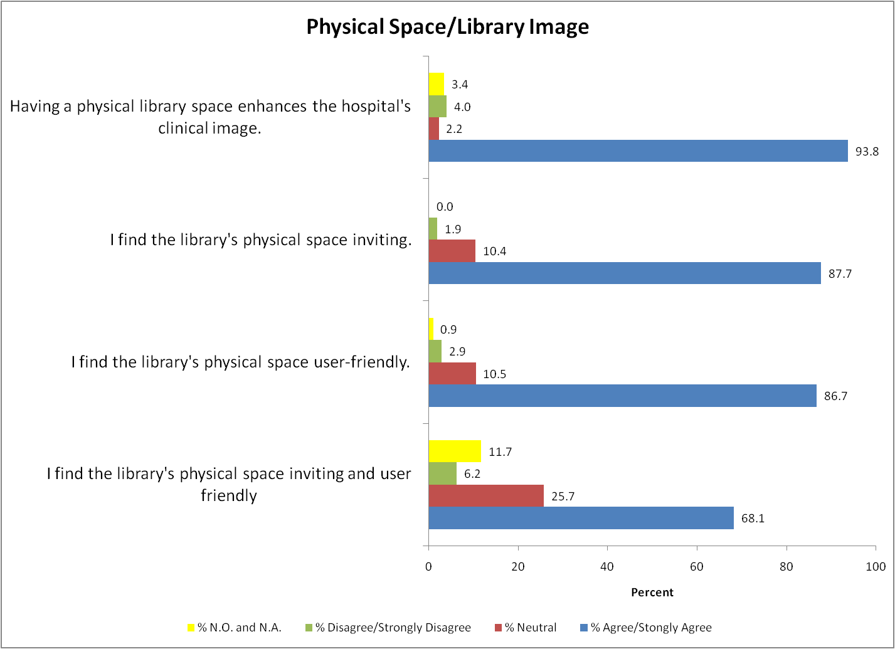

Slide 9
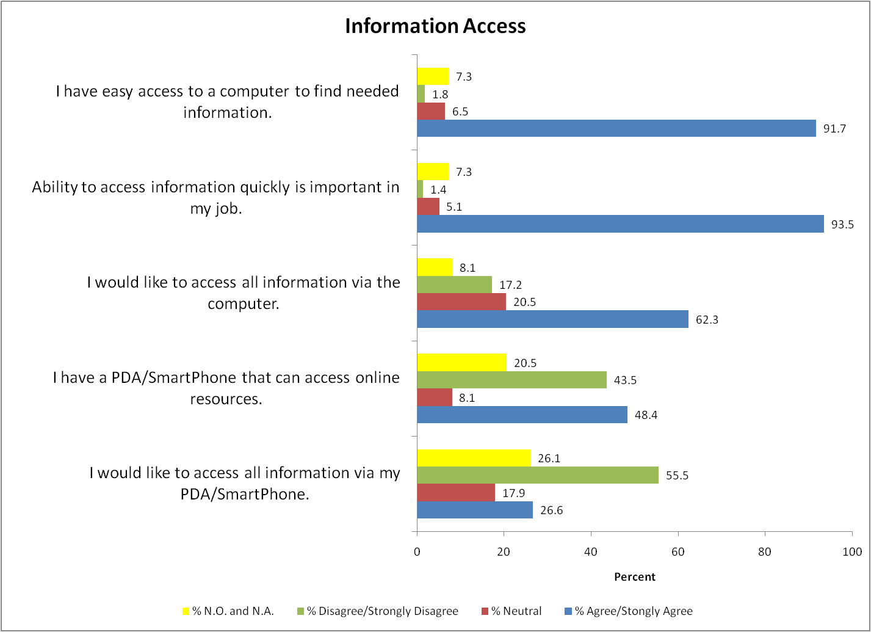

Slide 10
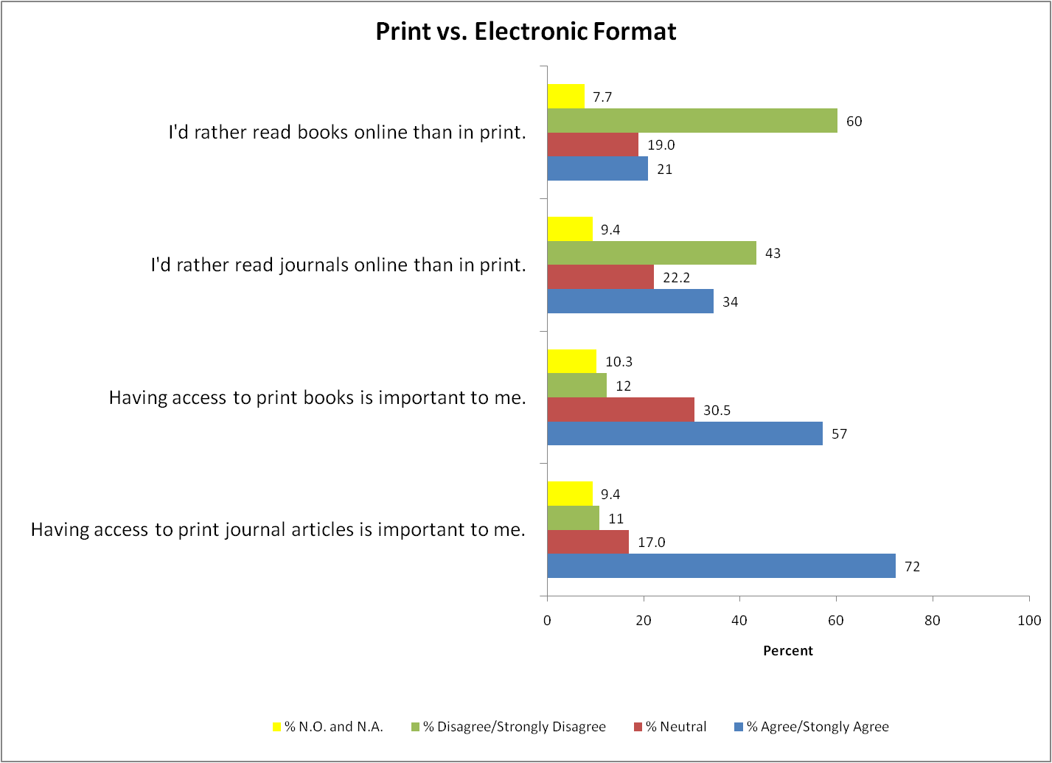

Slide 11
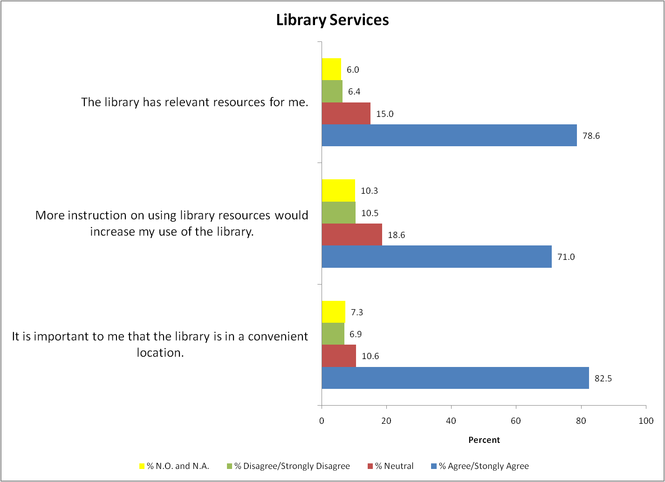

Slide 12
Conclusions
It is understood that data may be skewed due to the low percentage of staff that completed the survey and that those completing the survey were likely supporters/users of the library.
A physical library space that is convenient for the user is important for the clinical image of the hospital.
Although a majority state they have time to find information and the information is useful in patient care, approximately 3 out of 4 also agreed that a dedicated librarian on their team would further improve patient care.

Slide 13
Conclusions
Most need to access information quickly for their job and they have access to a computer. However, the need to access information via a PDA/Smartphone is not supported.
A majority maintain a desire for access to print collections (both books and journals).
Approximately 7 out of 10 stated that more library instruction would increase their use of the library’s resources.

